Slide 1

Software Engineering
Software Project Management, Architecture & Design
Software Design
Department of Computer Science and Engineering
Acknowledgement: Authors of the prescribed textbooks and materials sourced online.
‹#›

Slide 2

Software Design
List of Contents
Contrasting Structured and Object Oriented Approaches
Department of Computer Science and Engineering
‹#›
‹#›

Slide 3
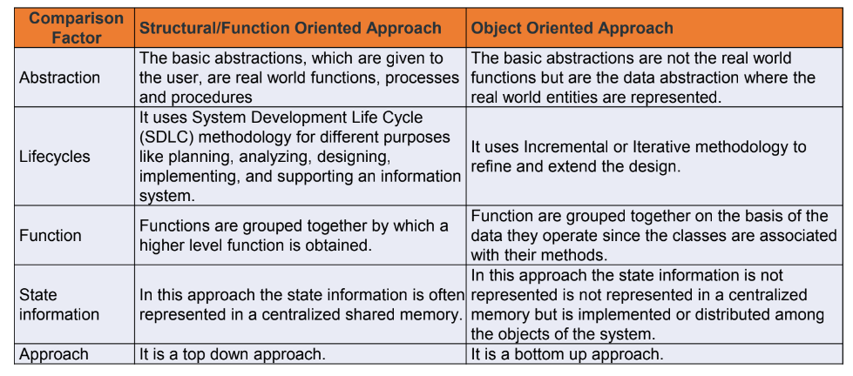
Contrasting Structured and Object Oriented Approaches

Slide 4
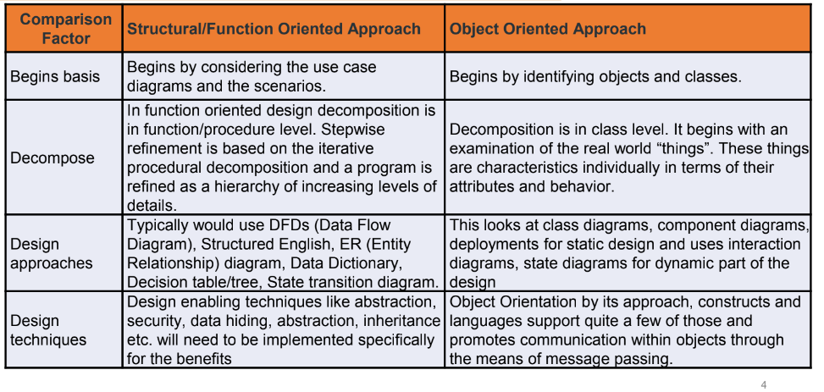
Contrasting Structured and Object Oriented Approaches

Slide 5
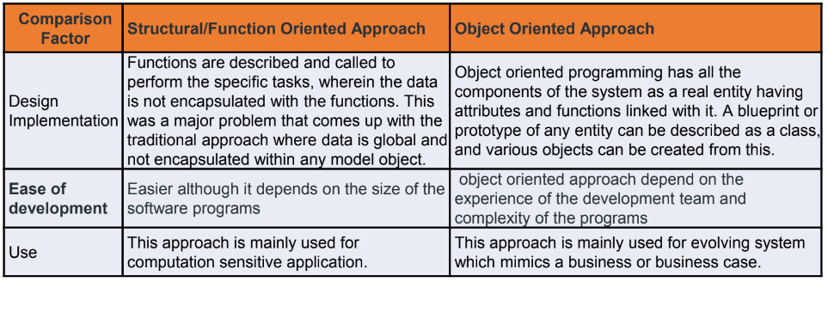
Contrasting Structured and Object Oriented Approaches

Slide 6
THANK YOU
Software Design
Department of Computer Science and Engineering
‹#›
‹#›

